Slide 1
The Way of the Cross
In the name of the Father, and of the Son, and of the Holy Spirit. Amen.
Then Jesus told his disciples, “If any want to become my followers, let them deny themselves and take up their cross and follow me. For those who want to save their life will lose it, and those who lose their life for my sake will find it.
Matthew 16.24,25
But now in Christ Jesus you who once were far off have been brought near by the blood of Christ. For he is our peace; in his flesh he has made both groups into one and has broken down the dividing wall, that is, the hostility between us.
Ephesians 2.13,14
Almighty and everlasting God, who in your tender love towards the human race sent your Son our Saviour Jesus Christ to take upon him our flesh and to suffer death upon the cross: grant that we may follow the example of his patience and humility, and also be made partakers of his resurrection; through Jesus Christ your Son our Lord, who is alive and reigns with you, in the unity of the Holy Spirit, one God, now and for ever. Amen.
Holy God, holy and strong, holy and immortal, have mercy upon us.

Slide 2
First Station:
Jesus in agony in the Garden of Gethsemane
A reading from the Gospel according to Mark.
They went to a place called Gethsemane; and he said to his disciples, ‘Sit here while I pray.’ He took with him Peter and James and John, and began to be distressed and agitated. And he said to them, ‘I am deeply grieved, even to death; remain here, and keep awake.’ And going a little farther, he threw himself on the ground and prayed that, if it were possible, the hour might pass from him. He said, ‘Abba, Father, for you all things are possible; remove this cup from me; yet, not what I want, but what you want.’
Mark 14.32-36

Slide 3
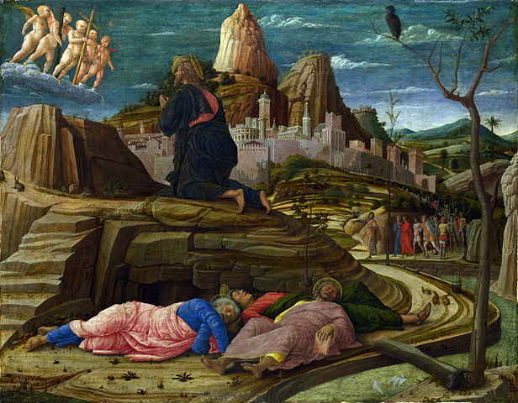
The Agony in the Garden
1455
Andrea Mantegna

Slide 4
Lord Jesus, you entered the garden of fear and faced the agony of your impending death: be with those who share that agony and face death unwillingly this day. You shared our fear and knew the weakness of our humanity: give strength and hope to the dispirited and despairing. To you, Jesus, who sweated blood, be honour and glory with the Father and the Holy Spirit, now and for ever.
Amen.
Holy God, holy and strong, holy and immortal, have mercy upon us.

Slide 5
Second Station:
Jesus betrayed by Judas and arrested
A reading from the Gospel according to Mark.
Immediately, while he was still speaking, Judas, one of the twelve, arrived; and with him there was a crowd with swords and clubs, from the chief priests, the scribes, and the elders. Now the betrayer had given them a sign, saying, ‘The one I will kiss is the man; arrest him and lead him away under guard.’ So when he came, he went up to him at once and said, ‘Rabbi!’ and kissed him. Then they laid hands on him and arrested him.
Mark 14.43-46

Slide 6
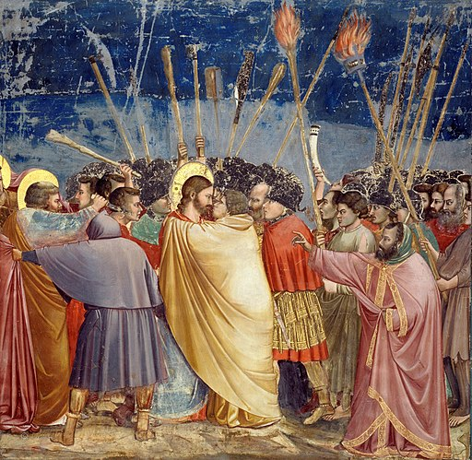
The Kiss of Judas
1306
Giotto di Bondone

Slide 7
Lord Jesus, you entered the garden of fear and faced the agony of your impending death: be with those who share that agony and face death unwillingly this day. You shared our fear and knew the weakness of our humanity: give strength and hope to the dispirited and despairing. To you, Jesus, who sweated blood, be honour and glory with the Father and the Holy Spirit, now and for ever.
Amen.
Holy God, holy and strong, holy and immortal, have mercy upon us.

Slide 8
Third Station:
Jesus condemned by the Sanhedrin
A reading from the Gospel according to Mark.
Now the chief priests and the whole council were looking for testimony against Jesus to put him to death; but they found none. For many gave false testimony against him, and their testimony did not agree. Some stood up and gave false testimony against him, saying, ‘We heard him say, “I will destroy this temple that is made with hands, and in three days I will build another, not made with hands”.’ But even on this point their testimony did not agree. Then the high priest stood up before them and asked Jesus, ‘Have you no answer? What is it that they testify against you?’ But he was silent and did not answer. Again the high priest asked him, ‘Are you the Messiah, the Son of the Blessed One?’ Jesus said, ‘I am; and “you will see the Son of Man seated at the right hand of the Power”, and “coming with the clouds of heaven”.’ Then the high priest tore his clothes and said, ‘Why do we still need witnesses? You have heard his blasphemy! What is your decision?’ All of them condemned him as deserving death.
Mark 14.55-64

Slide 9
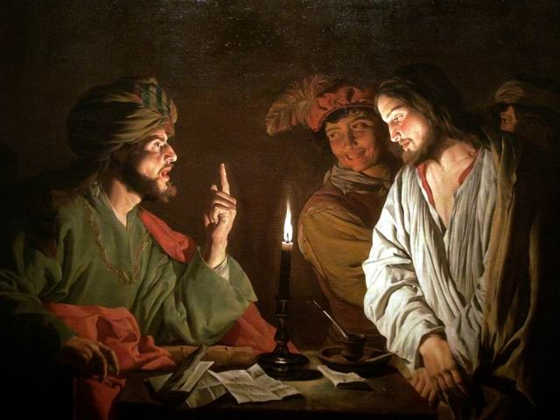
Jesus before Caiaphas
c. 1630
Matthias Stom

Slide 10
Lord Jesus, you were the victim of religious bigotry: be with those who are persecuted by small-minded authority. You faced the condemnation of fearful hearts: deepen the understanding of those who shut themselves off from the experience and wisdom of others. To you, Jesus, unjustly judged victim, be honour and glory with the Father and the Holy Spirit, now and for ever. Amen.
Holy God, holy and strong, holy and immortal, have mercy upon us.

Slide 11
Fourth Station:
Peter denies Jesus
A reading from the Gospel according to Mark.
At that moment the cock crowed for the second time. Then Peter remembered that Jesus had said to him, ‘Before the cock crows twice, you will deny me three times.’ And he broke down and wept.
Mark 14.72

Slide 12
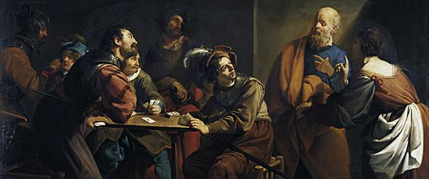
The Denial of Saint Peter, Theodoor Rombouts, 1789

Slide 13
Lord Jesus, as Peter betrayed you, you experienced the double agony of love rejected and friendship denied: be with those who know no friends and are rejected by society. You understood the fear within Peter: help us to understand the anxieties of those who fear for their future. To you, Jesus, who gazed with sadness at your lost friend, be honour and glory with the Father and the Holy Spirit, now and for ever.
Amen.
Holy God, holy and strong, holy and immortal, have mercy upon us.

Slide 14
Fifth Station:
Jesus judged by Pilate
A reading from the Gospel according to Mark.
Pilate asked them, ‘Why, what evil has he done?’ But they shouted all the more, ‘Crucify him!’ So Pilate, wishing to satisfy the crowd, released Barabbas for them; and after flogging Jesus, he handed him over to be crucified.
Mark 15:14,15

Slide 15
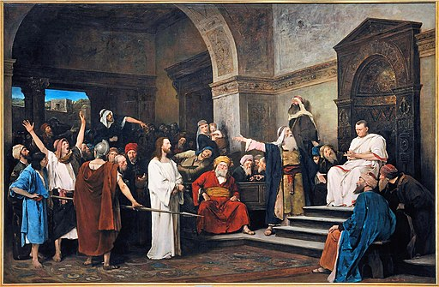
Christ before Pilate 1881
Mihály Munkácsy

Slide 16
Lord Jesus, you were condemned to death for political expediency: be with those who are imprisoned for the convenience of the powerful. You were the victim of unbridled injustice: change the minds and motivations of oppressors and exploiters to your way of peace. To you, Jesus, innocent though condemned, be honour and glory with the Father and the Holy Spirit, now and for ever. Amen.
Holy God, holy and strong, holy and immortal, have mercy upon us.

Slide 17
Sixth Station:
Jesus scourged and crowned with thorns
A reading from the Gospel according to Mark.
And they clothed him in a purple cloak; and after twisting some thorns into a crown, they put it on him. And they began saluting him, ‘Hail, King of the Jews!’ They struck his head with a reed, spat upon him, and knelt down in homage to him.
Mark 15:17-19

Slide 18
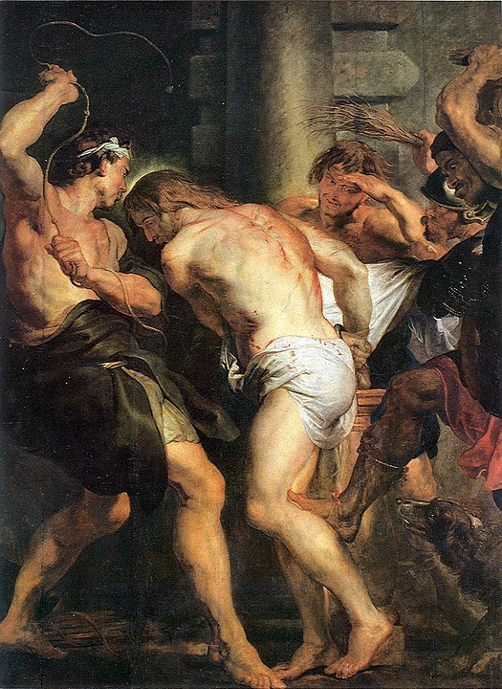
Flagellation of Christ
1617
Rubens

Slide 19
Lord Jesus, you faced the torment of barbaric punishment and mocking tongue: be with those who cry out in physical agony and emotional distress. You endured unbearable abuse: be with those who face torture and mockery in our world today. To you, Jesus, the King crowned with thorns, be honour and glory with the Father and the Holy Spirit, now and for ever.
Amen.
Holy God, holy and strong, holy and immortal, have mercy upon us.

Slide 20
Seventh Station:
Jesus carries the cross
A reading from the Gospel according to Mark.
After mocking him, they stripped him of the purple cloak and put his own clothes on him. Then they led him out to crucify him.
Mark 15:20

Slide 21
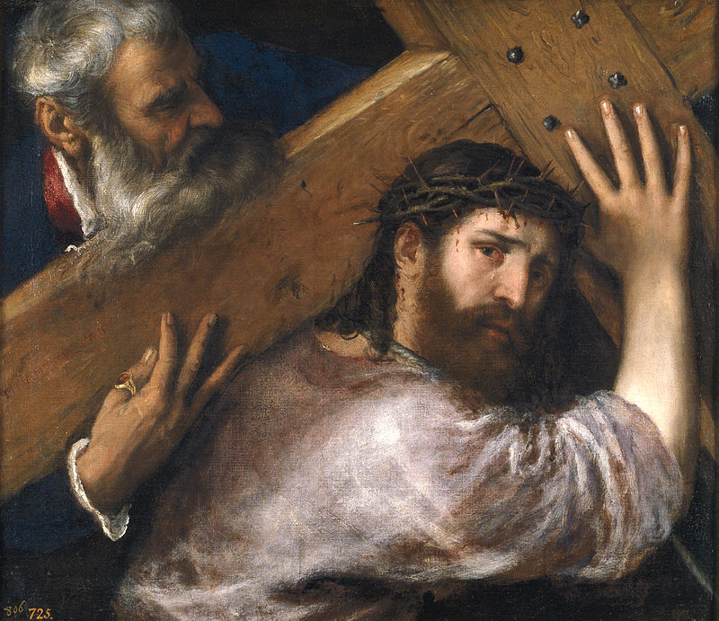
Christ Carrying the Cross 1565
Titian

Slide 22
Lord Jesus, you carried the cross through the rough streets of Jerusalem: be with those who are loaded with burdens beyond their strength. You bore the weight of our sins when you carried the cross: help us to realize the extent and the cost of your love for us. To you, Jesus, bearing a cross not your own, be honour and glory with the Father and the Holy Spirit, now and for ever.
Amen.
Holy God, holy and strong, holy and immortal, have mercy upon us.

Slide 23
Eighth Station:
Simon of Cyrene helps Jesus to carry the cross
A reading from the Gospel according to Mark.
They compelled a passer-by, who was coming in from the country, to carry his cross; it was Simon of Cyrene, the father of Alexander and Rufus.
Mark 15:21

Slide 24
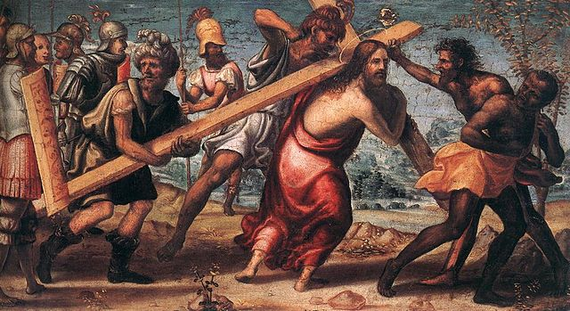
The Road to Calvary
1510
Il Sodoma

Slide 25
Lord Jesus, you were worn down by fatigue: be with those from whom life drains all energy. You needed the help of a passing stranger: give us the humility to receive aid from others. To you, Jesus, weighed down with exhaustion and in need of help, be honour and glory with the Father and the Holy Spirit, now and for ever. Amen.
Holy God, holy and strong, holy and immortal, have mercy upon us.

Slide 26
Ninth Station:
Jesus meets the women of Jerusalem
A reading from the Gospel according to Luke.
A great number of the people followed him, and among them were women who were beating their breasts and wailing for him. But Jesus turned to them and said, ‘Daughters of Jerusalem, do not weep for me, but weep for yourselves and for your children. For the days are surely coming when they will say, “Blessed are the barren, and the wombs that never bore, and the breasts that never nursed.” Then they will begin to say to the mountains, “Fall on us”; and to the hills, “Cover us.” For if they do this when the wood is green, what will happen when it is dry?’
Luke 23.27-31

Slide 27
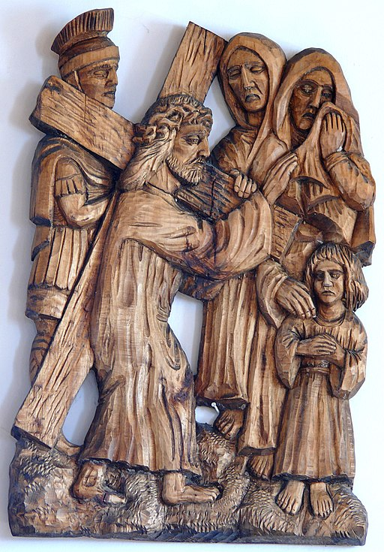
Jesus meets the daughters of Jerusalem, Church of St. John Nepomucen in Brenna

Slide 28
Lord Jesus, the women of Jerusalem wept for you: move us to tears at the plight of the broken in our world. You embraced the pain of Jerusalem, the ‘city of peace’: bless Jerusalem this day and lead it to the path of profound peace. To you, Jesus, the King of peace who wept for the city of peace, be honour and glory with the Father and the Holy Spirit, now and for ever.
Amen.
Holy God, holy and strong, holy and immortal, have mercy upon us.

Slide 29
Tenth Station:
Jesus is crucified
A reading from the Gospel according to Mark.
And they crucified him, and divided his clothes among them, casting lots to decide what each should take.
Mark 15:24

Slide 30
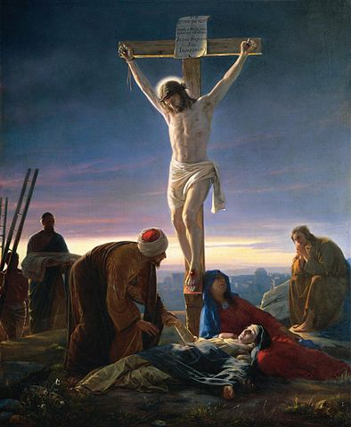
Christ on the Cross
1870
Carl Heinrich Bloch

Slide 31
Lord Jesus, you bled in pain as the nails were driven into your flesh: transform through the mystery of your love the pain of those who suffer. To you, Jesus, our crucified Lord, be honour and glory with the Father and the Holy Spirit, now and for ever. Amen.
Holy God, holy and strong, holy and immortal, have mercy upon us.

Slide 32
Eleventh Station:
Jesus promises the kingdom to the penitent thief
A reading from the Gospel according to Luke.
One of the criminals who were hanged there kept deriding him and saying, ‘Are you not the Messiah? Save yourself and us!’ But the other rebuked him, saying, ‘Do you not fear God, since you are under the same sentence of condemnation? And we indeed have been condemned justly, for we are getting what we deserve for our deeds, but this man has done nothing wrong.’ Then he said, ‘Jesus, remember me when you come into your kingdom.’ He replied, ‘Truly I tell you, today you will be with me in Paradise.’
Luke 23:29-43

Slide 33
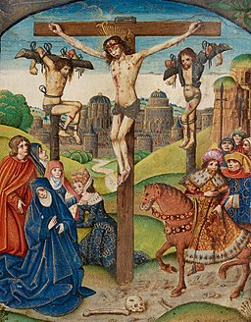
Christ on the Cross between two thieves
Illumination from the Vaux Passional
16th century

Slide 34
Lord Jesus, even in your deepest agony you listened to the crucified thief: hear us as we unburden to you our deepest fears. You spoke words of love in your hour of death: help us to speak words of life to a dying world. To you, Jesus, who offer hope to the hopeless, be honour and glory with the Father and the Holy Spirit, now and for ever. Amen.
Holy God, holy and strong, holy and immortal, have mercy upon us.

Slide 35
Twelfth Station:
Jesus on the cross; his mother and his friend
A reading from the Gospel according to John.
When Jesus saw his mother and the disciple whom he loved standing beside her, he said to his mother, ‘Woman, here is your son.’ Then he said to the disciple, ‘Here is your mother.’ And from that hour the disciple took her into his own home.
John 19.26,27

Slide 36
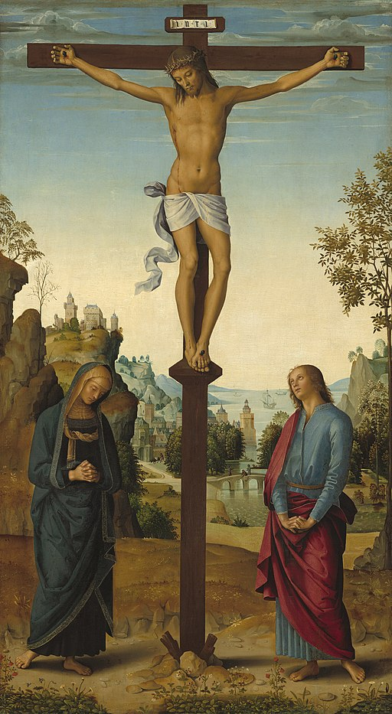
Mary at the Cross
1482
Pietro Perugino

Slide 37
Lord Jesus, your mother and your dearest friend stayed with you to the bitter end, yet even while racked with pain you ministered to them: be with all broken families today and care for those who long for companionship. You cared for your loved ones even in your death-throes: give us a love for one another that is stronger even than the fear of death. To you, Jesus, loving in the face of death, be honour and glory with the Father and the Holy Spirit, now and for ever.
Amen.
Holy God, holy and strong, holy and immortal, have mercy upon us.

Slide 38
Thirteenth Station:
Jesus dies on the cross
We adore you, O Christ, and we bless you, because by your holy cross you have redeemed the world.
A reading from the Gospel according to Mark.
At three o’clock Jesus cried out with a loud voice, ‘Eloi, Eloi, lema sabachthani?’ which means, ‘My God, my God, why have you forsaken me?’ When some of the bystanders heard it, they said, ‘Listen, he is calling for Elijah.’ And someone ran, filled a sponge with sour wine, put it on a stick, and gave it to him to drink, saying, ‘Wait, let us see whether Elijah will come to take him down.’ Then Jesus gave a loud cry and breathed his last.
Mark 15:34-37

Slide 39
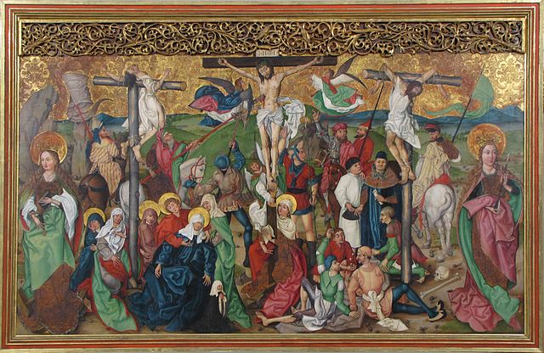
Crucifixion, from the Buhl Altarpiece
circa 1495−1500
Followers of Martin Schongauer

Slide 40
Lord Jesus, you died on the cross and entered the bleakest of all circumstances: give courage to those who die at the hands of others. In death you entered into the darkest place of all: illumine our darkness with your glorious presence. To you, Jesus, your lifeless body hanging on the tree of shame, be honour and glory with the Father and the Holy Spirit, now and for ever.
Amen.
Holy God, holy and strong, holy and immortal, have mercy upon us.

Slide 41
Fourteenth Station:
Jesus laid in the tomb
We adore you, O Christ, and we bless you, because by your holy cross you have redeemed the world.
A reading from the Gospel according to Mark.
Then Joseph bought a linen cloth, and taking down the body, wrapped it in the linen cloth, and laid it in a tomb that had been hewn out of the rock. He then rolled a stone against the door of the tomb.
Mark 15:46

Slide 42
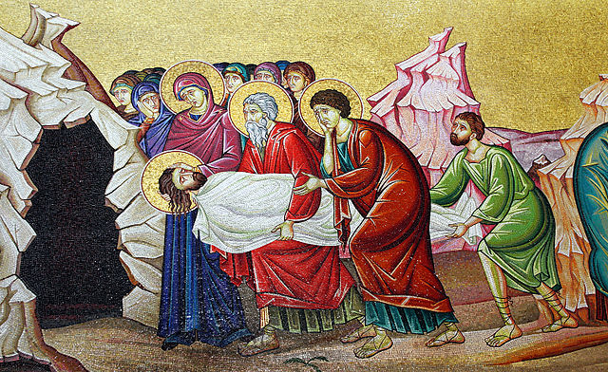
Wall mosaic of entombment of Jesus near Stone of anointing at Church of the Holy Sepulchre
(modern)

Slide 43
Lord Jesus, Lord of life, you became as nothing for us: be with those who feel worthless and as nothing in the world’s eyes. You were laid in a cold, dark tomb and hidden from sight: be with all who suffer and die in secret, hidden from the eyes of the world. To you, Jesus, your rigid body imprisoned in a tomb, be honour and glory with the Father and the Holy Spirit, now and for ever. Amen.
Holy God, holy and strong, holy and immortal, have mercy upon us.

Slide 44
Fifteenth Station:
Jesus risen from the dead
We adore you, O Christ, and we bless you, because by your holy cross you have redeemed the world.
A reading from the Gospel according to Mark.
When they looked up, they saw that the stone, which was very large, had already been rolled back. As they entered the tomb, they saw a young man, dressed in a white robe, sitting on the right side; and they were alarmed. But he said to them, ‘Do not be alarmed; you are looking for Jesus of Nazareth, who was crucified. He has been raised; he is not here. Look, there is the place they laid him. But go, tell his disciples and Peter that he is going ahead of you to Galilee; there you will see him, just as he told you.’ So they went out and fled from the tomb, for terror and amazement had seized them; and they said nothing to anyone, for they were afraid.
Mark 16.4-8

Slide 45
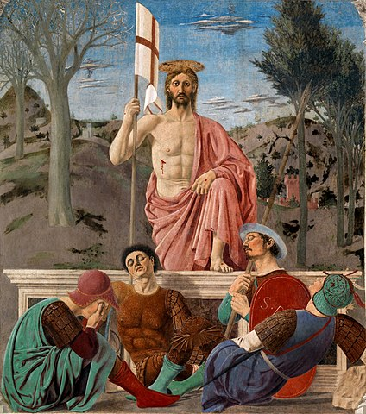
The Resurrection
15th century
Piero della Francesca

Slide 46
Lord Jesus, you were dead but now you are alive: transform the torments of this world’s sin that we may see your radiant glory. You were raised from death to life: may the power of your resurrection live in us, that we may be channels of your true life beyond measure. To you, Jesus, who have broken free from the bonds of death, be honour and glory with the Father and the Holy Spirit, now and for ever. Amen.
Holy God, holy and strong, holy and immortal, have mercy upon us.

Slide 47
The Conclusion
Let us pray for the coming of God’s kingdom
in the words our Saviour taught us.
Our Father in heaven,
hallowed be your name,
your kingdom come,
your will be done,
on earth as in heaven.
Give us today our daily bread.
Forgive us our sins
as we forgive those who sin against us.
Lead us not into temptation
but deliver us from evil.
For the kingdom, the power,
and the glory are yours
now and for ever.
Amen.

Slide 48
Most merciful God, who by the death and resurrection of your Son Jesus Christ delivered and saved the world: grant that by faith in him who suffered on the cross we may triumph in the power of his victory; through Jesus Christ your Son our Lord, who is alive and reigns with you, in the unity of the Holy Spirit, one God, now and for ever. Amen.
We adore you, O Christ, and we bless you, because by your holy cross you have redeemed the world. Christ was manifested in the body, vindicated in the spirit, seen by angels, proclaimed among the nations, believed in throughout the world, glorified in high heaven. We adore you, O Christ, and we bless you, because by your holy cross you have redeemed the world.
May God bless us, that in us may be found love and humility, obedience and thanksgiving, discipline, gentleness and peace. Amen.
copyright © The Archbishops' Council of the Church or England

